Slide 1
Information fusion for decision making
Homagni Saha
Major Professor: Dr. Soumik Sarkar
Committee: Dr. Sourabh Bhattacharya, Dr. Chinmay Hegde
Dr. Baskar Ganapathysubramanian, Dr. Jin Tian
05/07/2021
Notes:
Good morning and welcome to my final phd oral defense on Information fusion for decision making

Slide 2
Outline
Introduction
Multimodal information fusion – Data level, Feature level and Decision level
Multimodal decision level information fusion – Representation, Event, Goal based
Summary of my previous works
Vision and Language information fusion – Why and how
Vision Language Navigation
Existing frameworks
MOVILAN – A modular framework for vision language instruction following
Modules- Mapping, Language Understanding, Cross modal grounding, Disambiguation, Planning
Future work
Discussion
Notes:
(click) First I will talk about different kinds of multimodal information fusion (click) , data level, feature level and decision level
Then as my presentation is based on decision making, I will set out three subcategories of multimodal decision level information fusion
Then I will relate each of these categories to the previous works I have presented in my qualifier and prelims exams
(click) After that I will talk about todays topic which brings all the different paradigms of multimodal decision level fusion together
Which is Vision Language Navigation
First I will talk a bit about vision language information fusion (click)
Then give an idea about the problem of vision language navigation(click) (click) (click)
After then I will talk about our proposed modular solution and its different modules which work together to achieve information fusion
Finally, I will end with future work and discussion

Slide 3

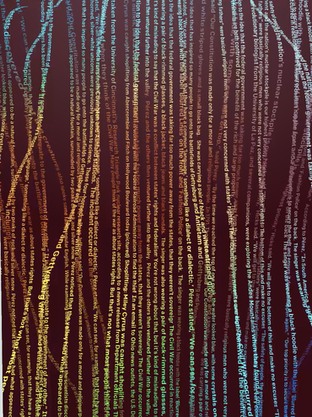
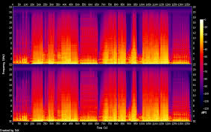
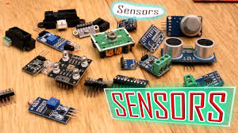
Multimodal information fusion
Image processing
Robotics and security systems
Machine Learning
Text processing
Multimodal
Pattern Recognition
Biomedical imaging and eHealth systems
Optimization
Applications
Audio processing
Fusion
Data Mining
Software Engineering
Environment and habitat monitoring systems
Sensor data processing
Notes:
Information about a phenomenon or a system of interest can be obtained from different types of instruments, measurement techniques, experimental setups, and other types of sources.
Multimodal information fusion deals with techniques by which we can obtain more information about the system
By looking at the data from various sensor modalities
It has various interesting applications as shown here and interested sub fields of research as shown in hexagonal boxes

Slide 4
Common information fusion strategies
Classifier/Mapping
Classifier/Mapping
Classifier/Mapping
Combine
Classifier
Classifier
Pooling
Pooling
Modality 1
Modality 2
Modality 1
Modality 2
Mapping
Similar
Decision level fusion
Data in- data out
Decision in- decision out
Data level fusion
Data in- feature out
Mapping
Modality 1
Modality 2
Modality 2
Modality 1
[2] Lahat, Dana, Tülay Adali, and Christian Jutten. "Multimodal data fusion: an overview of methods, challenges, and prospects." Proceedings of the IEEE 103.9 (2015): 1449-1477.
Feature level
Feature in- Feature out
Feature in-decision out
Notes:
In this slide I have tried to pictorially represent various information fusion strategies.
Starting from the left first we may have individual modalities being passed through respective classifiers or combined together using a set of rules- these methods fall in the broad range of decision level fusion
Then we have data level fusion where features can be extracted from input modalities and concatenated together before being passed into a classifier or mapping
Finally we have Feature level fusion which focus on finding relationships between extracted features from modalities and combining them through pooling operations or classifiers or mappings.
In most of my PhD work, I have focused on decision level fusion which is represented by the leftmost figure

Slide 5
Multimodal decision level information fusion
Combine
Representation based
Event based
Goal based
Classifier
Classifier
Modality 1
Modality 2
Decision level fusion
Data in- data out
Decision in- decision out
Notes:
Within multimodal decision level fusion, based on the different projects I have worked on, techniques might be classified into representation based, event based, and goal based
In representation based, data from various modalities need to be combined into a single representation and then we can take a decision on the newly represented data
It has a very similar flavor to feature level fusion, however here we must take a decision based upon the joint representation.
Next is event based, here the decision to utilize information from one modality is itself a decision or what we can call an event.
Based upon when that event is triggered, we can look at the data from that event and then take a decision
Each event can be triggered by an individual modality
Then we have Goal based. Here information across multiple modalities are fused depending on an overall goal that needs to be achieved by the entire system
In the next slide I will go over examples of these techniques with regards to the work I have done in order to make this more clear

Slide 6
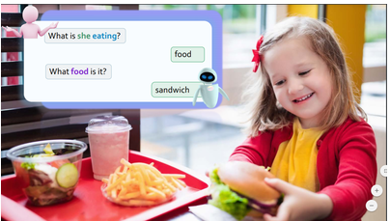
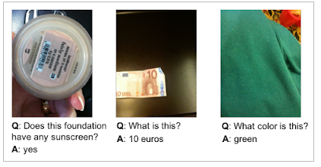
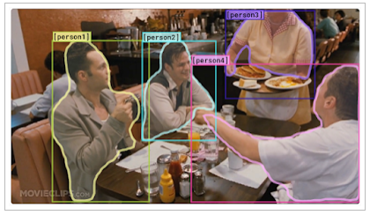
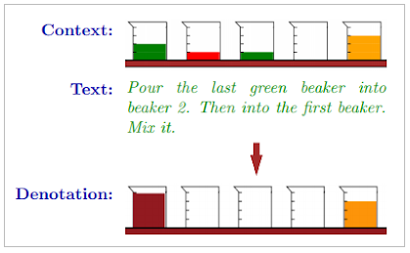
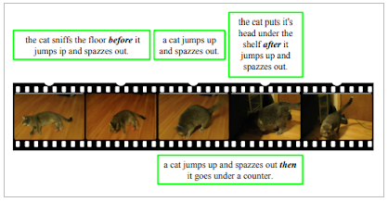
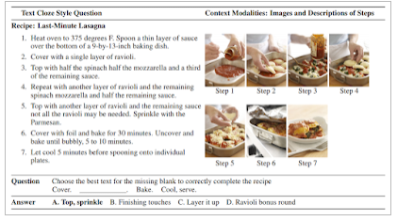
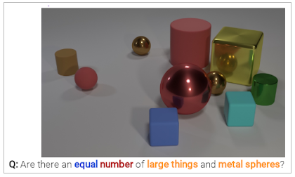
Vision language information fusion
Notes:
Before diving into the problem, I will talk a bit about Vision and Language information fusion.
Vision and Language are two very common modalities that currently have vastly available annotated data
Covering various challenging problem definitions such as object detection, sentiment analysis and speech recognition
Recently the research community have also focused on an interesting set of problems that require pooling information from
Both the modalities drawing us even closer to the concept of a general artificially intelligent system that can correlate the knowledge within the two modalities
Suppose I show an agent a picture and tell something about the picture in natural language a greater level of understanding needs to be achieved
Here I have provided examples from a few currently available challenges
From left to right and top to bottom
The top left is GQA 2019 dataset, aim is for fine grained diagnosis of presented visual scenes through natural language commands like in this example what is she eating
There is VizWiz which was proposed to empower blind people to request information about the world in natural language
There is VCR or Visual CommonSenseReasoning dataset for cognition level visual understanding. In addition to answering natural language questions must also provide a rationale on why it is true by highlighting the image
There is the SCONE or Sequential CONtext dependent Execution dataset the task is to execute a sequence of actions
based on visual description of the task and natural language description for ex- pour the first green beaker into beaker 2
In the bottom from left we have TEMPO dataset or temporal reasoning in video and language, localizing moments in videos based on natural language descriptions
Then we have RecipeQA for multimodal comprehension of cooking recipes
Then we have CLEVR another visual question answering dataset but with focus on geometric shapes and positions of objects for training robotic grasping solutions

Slide 7
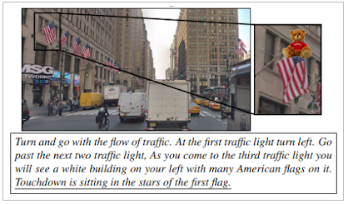
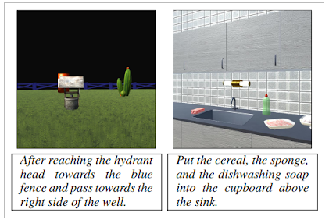
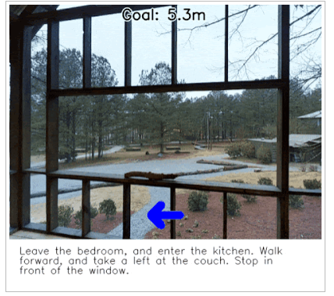
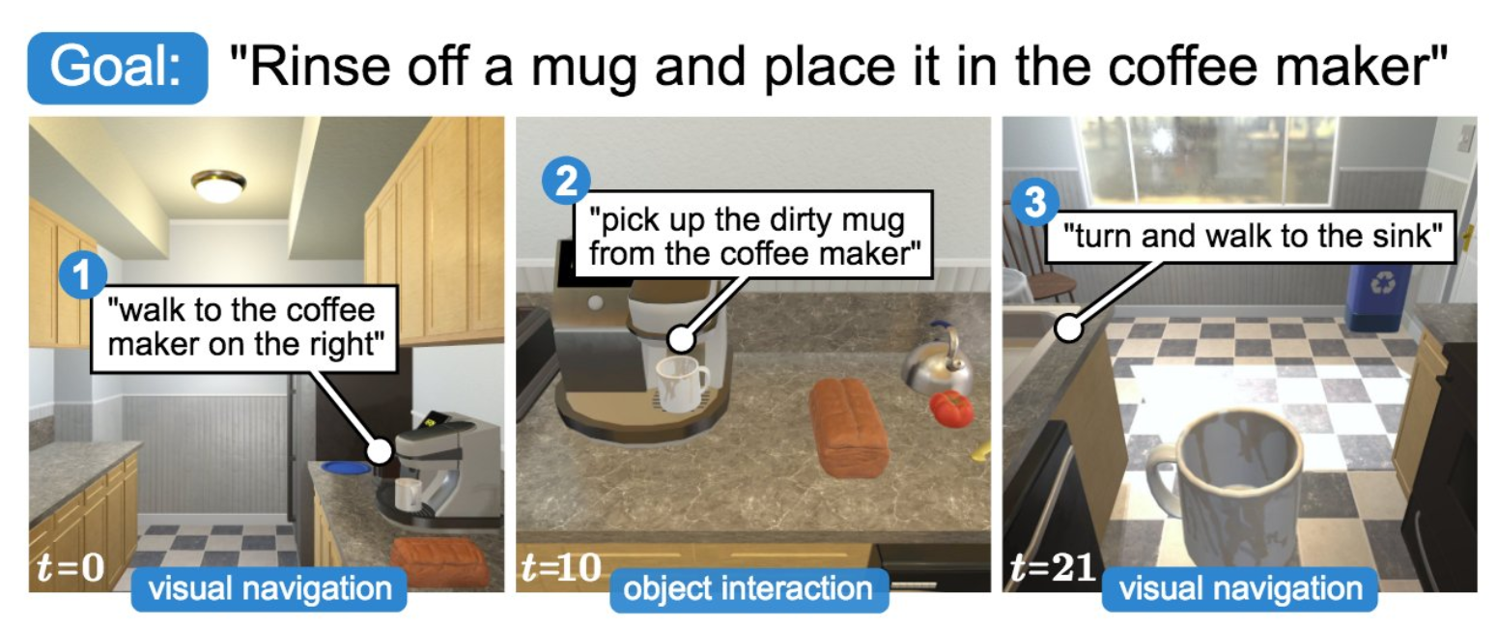
Vision Language Navigation
Notes:
A special type of problem among vision language multimodal fusion is Vision Language Navigation.
Here the primary task is execution of a sequence of motions in a physical environment perceived
by vision, with actions and intermediate or final navigation goals described in natural language
Several datasets were proposed starting from top left we have the touch down dataset which is aimed at navigating in streets based on certain points of interest described in natural language
Then there is a simplistic simulator dataset called CHALLET which had simple open world cartoonish environments as well as simulated indoor environments describing navigation tasks
Then there is the Room to Room R2R dataset which consists of real world images taken across hundreds of real houses in Australia with view points stitched according to the motion of the robot and natural language instructions describing final navigation goals
Finally on the bottom left we have the Ai2thor ALFRED dataset which is a super realistic indoor environment simulation
based on Unity with natural language instructions describing tasks both navigation and manipulation tasks to be performed
inside homes with extremely long natural language instructions. Imagine Alexa having arms and legs and being asked to do your household chores.

Slide 8
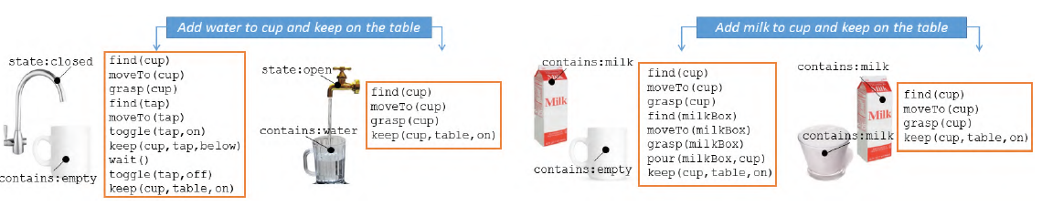
Existing approaches for indoor navigation (1/4)
Oldest known techniques put major focus on Language understanding aspect of the problem
Context sensitive parsers
1. Misra, Dipendra K., et al. "Tell me dave: Context-sensitive grounding of natural language to manipulation instructions." The International Journal of Robotics Research 35.1-3 (2016): 281-300.
Notes:
Now we will provide brief summary of existing approaches
Some of the early pioneering works in this field focused on the language understanding aspect of the problem
Effectively developing something called context sensitive parsers
In these kind of frameworks, you can enter a natural language instruction
And it would be converted into a specific parse syntax which can sequentially break down the instruction into a set of commands
For example, here you can see for the simple sentences like add water to cup
A lot of contextual actions are extracted such as find cup, move to cup, grasp cup and so on
One disadvantage of the framework is the problem with handcrafting these parse syntaxes
and producing new rules when new scenarios emerge

Slide 9
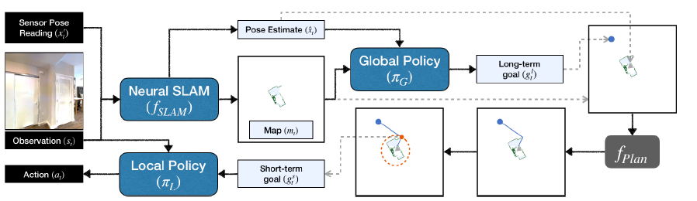
Existing approaches for indoor navigation (2/4)
Mapping based approaches
Curiosity driven exploration
Neural SLAM
Target object tracking
2. Chaplot, Devendra Singh, et al. "Learning to explore using active neural slam." arXiv preprint arXiv:2004.05155 (2020).
Notes:
Another branch of techniques that emerged started to focus more on the visual aspect of the surrounding
Environment like figuring out where the robot is at the current moment
And then figure out paths to a given target location by explicitly maintaining maps
Sometimes when navigation becomes difficult researchers also call for curiosity driven exploration strategies
Such concepts existed from the time SLAM approaches were being used, but with increasing use of deep neural networks
Researchers also started embedding deep neural networks into functional aspects of SLAM
Improving the mapping and exploration capabilities as shown in the example framework figure from the recent 2020 CVPR
Paper on neural SLAM
One disadvantage of this approach is the seemingly less focus on understanding the
relationship between the surroundings, language description and the agent action

Slide 10
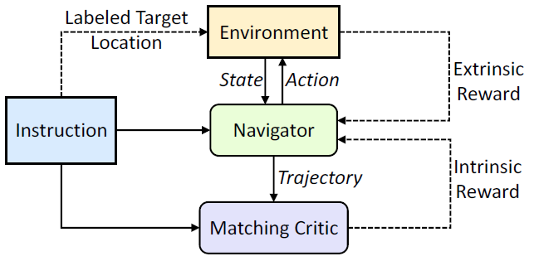
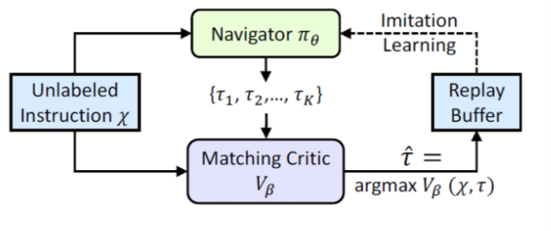
Existing approaches for indoor navigation (3/4)
End to end differentiable planning
Majority of Reinforcement learning based approaches
Self supervised imitation learning approaches
3. Wang, Xin, et al. "Reinforced cross-modal matching and self-supervised imitation learning for vision-language navigation." Proceedings of the IEEE/CVF Conference on Computer Vision and Pattern Recognition. 2019.
Notes:
Because of the difficulty in understanding the relationship
Between the current best action and the context being presented to the agent
There was another branch of approaches which could be grouped into end to end differentiable planning approaches
A majority of these techniques are based on reinforcement learning or self supervised imitation learning using LSTM and attention mechanisms
Here an example is shown from the well accepted research paper from 2018 CVPR which proposed a reinforced cross modal matching architecture
There is an actor critic reinforcement learning framework where critic looks through time embedded natural language instructions,
the environment and current state of the policy network navigator
The authors also introduced a self supervised imitation learning strategy by using a new type of reward
called cycled reconstruction reward, the probability of reconstructing given language instruction using observed trajectory of the robot
One disadvantage of these techniques is the requirement of perfectly aligned vision and language instruction data
Or several demonstrated expert trajectories which can be used to train the imitation learner
Or a controlled simulated environment where it is easy to obtain a precise reward for each action
These may lead to high annotation costs and create some scalability problems when introducing new actions

Slide 11
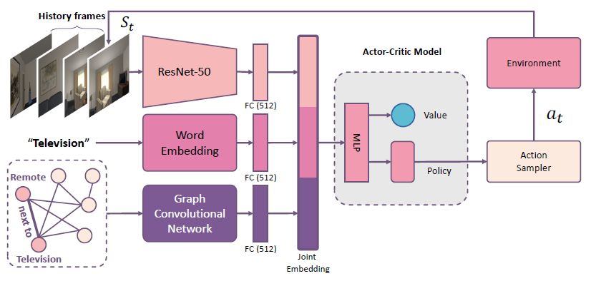
Existing approaches for indoor navigation (4/4)
End to end feature level fusion-based policy
Upfront feature level fusion
Connected to an action predictor- may be RL or sequence to sequence learning based
4. Yang, Wei, et al. "Visual semantic navigation using scene priors." arXiv preprint arXiv:1810.06543 (2018).
Notes:
Another kind of end to end learning approach involves upfront feature level
fusion connected in the end to an action predictor
Training can be reinforcement learning or sequence to sequence learning based
An example is shown here from the paper visual semantic navigation using scene priors
Here we can see that the authors combined the temporally stacked image frames,
Laguage instruction word embedding
And a mined knowledge graph representing relationship between objects
They combined the three modalities into a feature level fused layer which is then connected to an action predictor

Slide 12
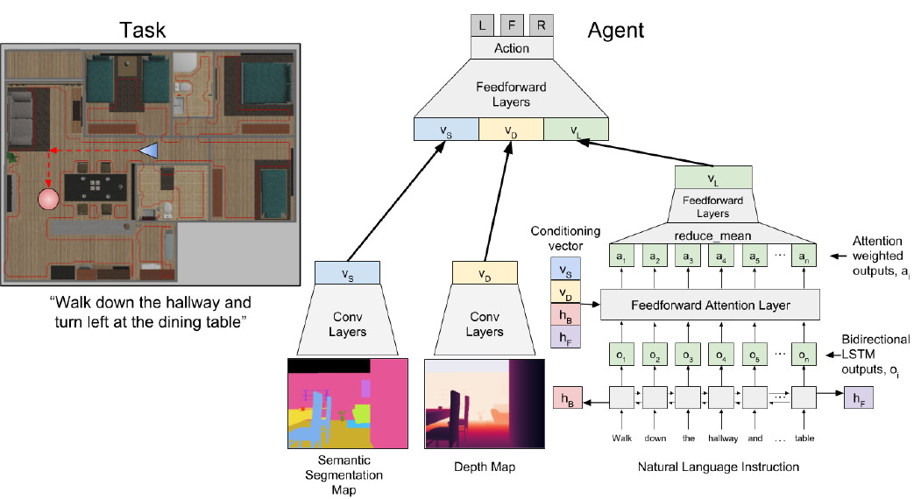
Existing approaches for indoor navigation (4/4)
5. Shah, Pararth, et al. "Follownet: Robot navigation by following natural language directions with deep reinforcement learning." arXiv preprint arXiv:1805.06150 (2018).
Notes:
Another similar paper shown here is titled FollowNet
Again in the architecture we can observe an upfront fusion
of semantic segmentation maps, depth map and natural language instruction features passed
through a bidirectional LSTM
Finally they are connected to an action predictor that predicts the actions left, right or forward

Slide 13
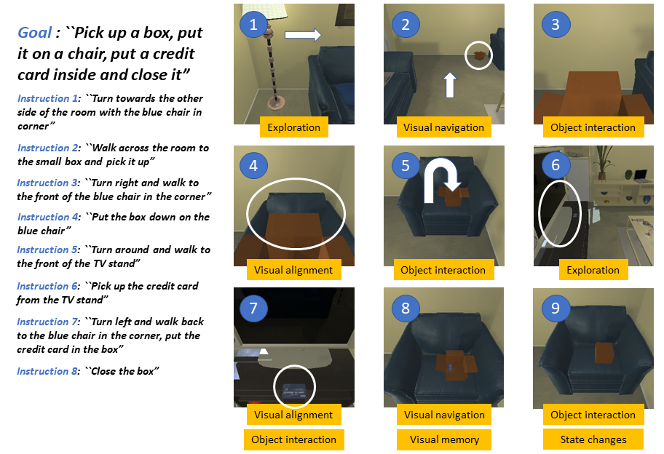
Long horizon and compositionality
Agent observe:
-RGB Image
-Depth normal
-Collision information
-Input textual natural language instructions
Agent action space:
-Navigation
--Move U/D/L/R
--Look up/ Look Down
-Object interaction
--Pickup (object)
--Place (object)
--Open/Close (something)
--Toggle On/Off (something)
Notes:
Long horizon goals and task compositionality are two most important things often overlooked by several approaches.
In real life for assistant robots to be helpful, they need to be able to understand long language instructions
That require extremely long sequence of actions for example action sequences ranging up to a length of 500 time steps
without the need for constant updates by the user
For example, the simple instruction shown here has a goal and a long sequence of 7 instructions in order
to fulfill the goal
It is easier to supply all the 7 instructions upfront to the robot, but it leads to an extremely long task
It also requires the robot to keep a track of which task has been completed when,
and which object has changed its state for example light have been turned on or box has been shifted already and so on
Also some instructions are compositional- for example put the credit card in the box,
for that you need to find the box, open the box and then put the credit card inside
Some instructions require visual understanding of the environment like instruction 1
Turn towards the other side of the room with the blue chair in the corner
Some instructions require tracking the motion of agent for example instruction 7
Turn left and walk back to the blue chair in the corner
long horizon and compositional aspects create problems for end to end learning approaches
which are generally trained using reinforcement learning leading to sparse rewards,
Or imitation learning leading to lack of sufficient examples for all object-task combinations
Context parsers are efficient in handling compositionality, whereas upfront feature level fusion
approaches are good in recognizing object-task relationships
Mapping based approaches are good in tracking state of agent and visually understanding the environment.
Therefore, we have combined all these advantages into a new modular approach as we will now present through the rest of the slides
The simulator environment shown here is what we have used. It is called Ai2Thor and the dataset is named ALFRED
The agent observation space is RGB image, depth image, collision information and input textual natural language instructions
The agent action space comprises of navigation actions like move and look and object interaction actions like
Pickup/place/open-close and turn on/off some appliance

Slide 14
Contributions
Modular approach for navigation and object interaction combining most previous aspects
Involve significantly longer execution trajectories and compositionality
Removes requirement of expensive trajectory demonstration data (coupled vision and language information)
Novel mapping technique
Transfer learning based natural language understanding
Much better success rates
Notes:
So these are the summary of contributions of my work
(read)

Slide 15
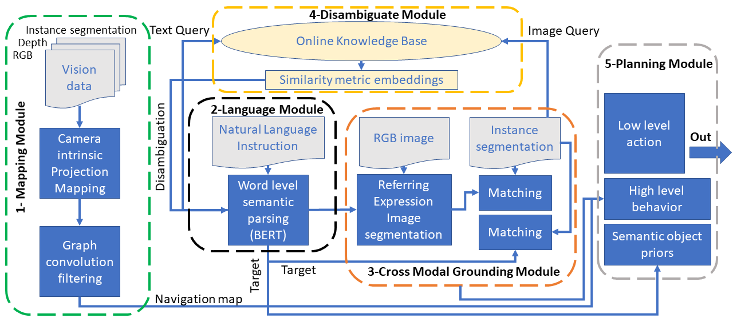
MOVILAN- A MOdular VIsion LANguage framework
Notes:
We propose a new modular framework for vision language navigation called MOVILAN
Short for Modular Vision Language.
First we have the mapping module which is tasked with localization and
maintaining explicit map of the surrounding space of the agent we have proposed a new graph convolution based approach
for goal based mapping
2nd is the Language module which borrows concepts from context based parsing, we use a new transfer learning strategy based
on the recent deep learning model called BERT
3rd is the cross modal grounding module which performs the task of upfront feature level fusion effectively grounding
natural language instructions to the visible objects around the agent
4th is the online disambiguation module which connects to an online knowledge base ex google search engine
and can generate queries to resolve ambiguities arising between the vision and the language module
Finally, the 5th module is planning which combines information from all the modules to generate agent actions

Slide 16
Mapping technique
We use a panorama image to first collect the entire visual information about the surroundings
An instance segmentation algorithm is used on the panorama image
Corresponding depth normal for all segmented regions are collected
The depth normal is combined with segmentation to create a Birds eye view projection
The projection obtained is continuously filtered using Graph convolution (our novelty)
Notes:
Now we will talk about the mapping module
(read)

Slide 17
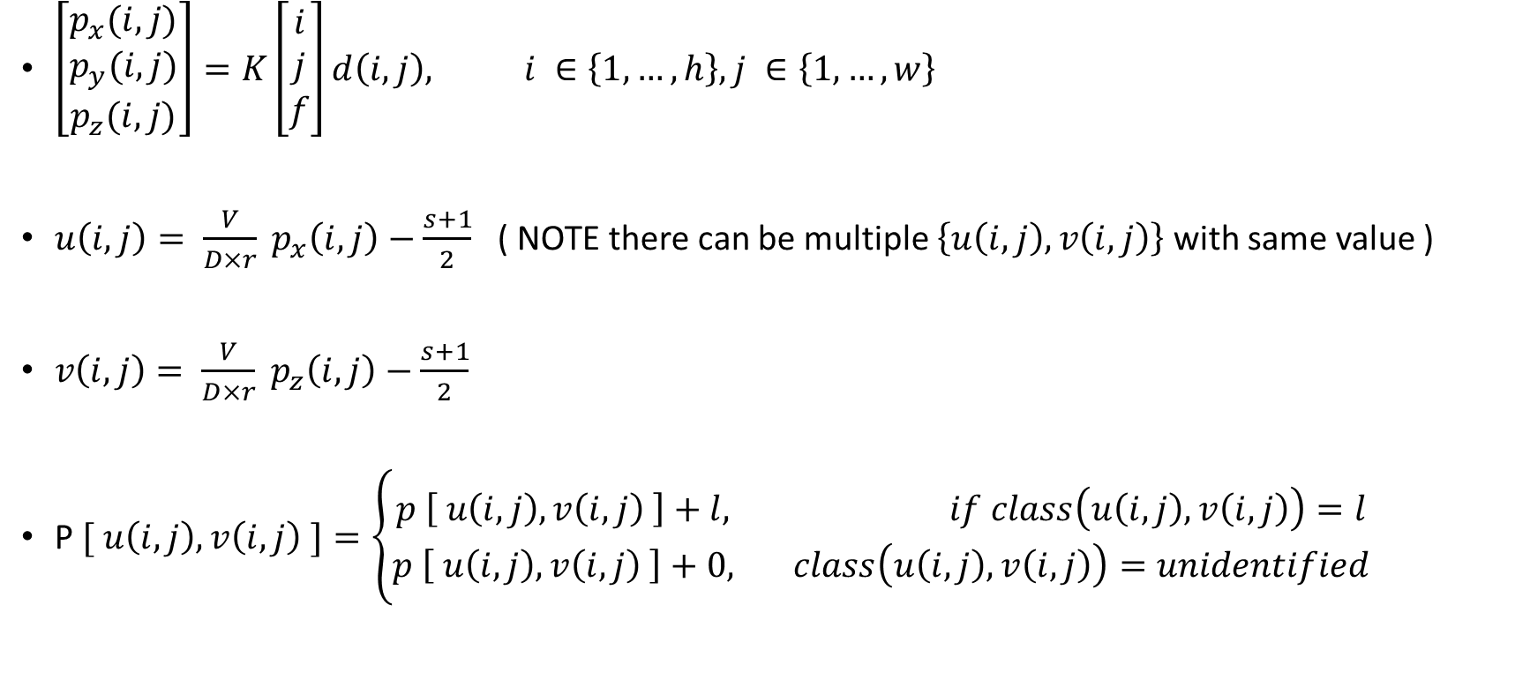
Geometric projection
$\left[\begin{aligned}p_{x}(i,j) \\ p_{y}(i,j) \\ p_{z}(i,j)\end{aligned}\right]=K\left[\begin{aligned}i \\ j \\ f\end{aligned}\right]d\left(i,j\right), i ∈\left\{1,…,h\right\}, j ∈\left\{1,…,w\right\}$
$u\left(i,j\right)= \frac{V}{D×r} p_{x}\left(i,j\right)−\frac{s+1}{2}$ ( NOTE there can be multiple $\left\{u\left(i,j\right),v\left(i,j\right)\right\}$ with same value )
$v\left(i,j\right)= \frac{V}{D×r} p_{z}\left(i,j\right)−\frac{s+1}{2}$
P$[ u\left(i,j\right), v\left(i,j\right) ]=\left\{\begin{aligned}p \left[ u\left(i,j\right), v\left(i,j\right) \right]+l, if class\left(u\left(i,j\right),v\left(i,j\right)\right)=l \\ &p \left[ u\left(i,j\right), v\left(i,j\right) \right]+0, class\left(u\left(i,j\right),v\left(i,j\right)\right)=unidentified\end{aligned}\right.$
Notes:
The first step for the mapping module is geometric projection
We take 3 different kinds of visual information- the RGB image, corresponding instance segmentation image and the corresponding depth image
h and w are the height and width of the images respectively
Using the camera calibration matrix K, the focal length f and the depth information at each pixel location d(I,j), we can calculate the point cloud information
Px(I,j), py(I,j) and pz(I,j)
After that we project the point cloud information into a birds eye view egocentric projection into the 2d plane of the agent
Here u(I,j) and v(I,j) maps the RGB pixel values (I,j) into the 2d index of the egocentric map around the agent
S is the size of the neighborhood around the agent, V is the maximum range of vision of the depth sensor, D is the maximum depth normal value and
r is the resolution of our map
The 2d indices u and v are also sometimes called competing elements of the projection
because multiple pixel locations (I,j) can map to the same egocentric map index location
The values at each index location u,v are stored in the matrix capital P using the simple formula shown here
If the instance segmentation class of the competing element is L then L is added to the current value stored in that grid location
Otherwise in case of unidentified class a 0 value is added

Slide 18
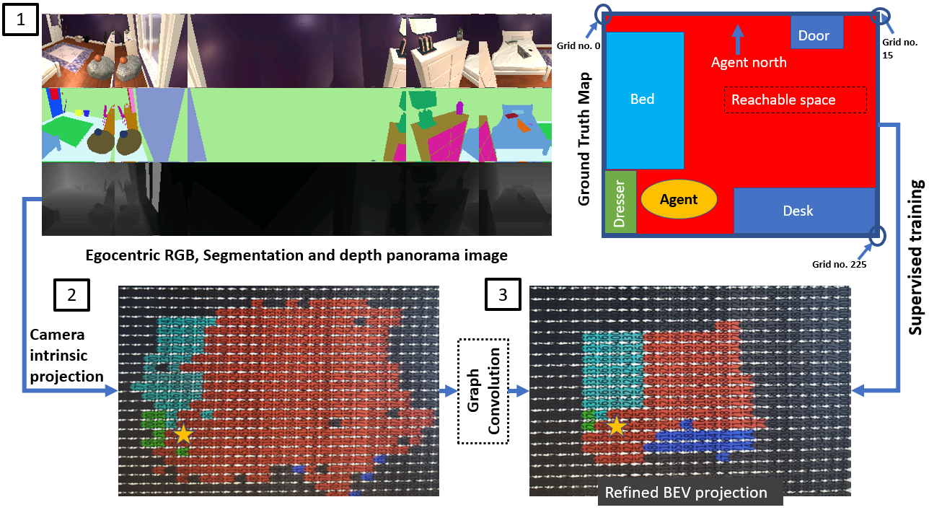
Training Framework
Notes:
Now we will explain a bit about how this module works
As you can see in top left figure 1, the 3 vision modalities- RGB, instance segmentation and depth information are available as panorama
Using the 3 vision modalities we can project the scene into an agent ego centric map
using the geometric projection technique explained to you in the previous slide
The problem with this approximate projection is that it can be very noisy and also does not
track and update the movement of the agent. To address this, we propose a novel graph convolution based map filtering approach
The approximate projection map after being passed through the graph convolution filter gets refined
to almost the ground truth birds eye view projection as seen in this example here
If we observe the rightmost segment of the panorama we are straight facing the bed and to our left is the dresser with the lamp on top
The ground truth in top right shows exactly this we have bed represented as cyan, dresser
represented in green and desk just beyond the basketball represented in blue
This ground truth is used to train the graph convolution filter in supervised manner and we get the
refined birds eye view projection as seen in the bottom right figure

Slide 19
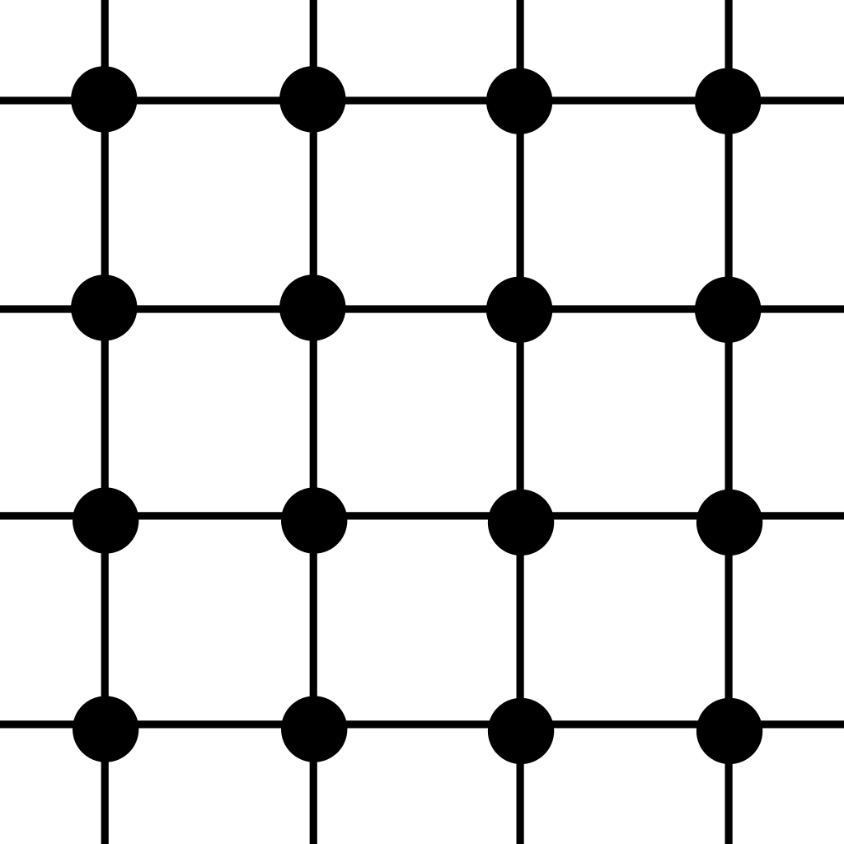

Graph Convolution
At each node
msg
Edge NN(msg)
Node target (one hot vector)
Node NN
Edge NN(msg)
Edge NN(msg)
msg
$$Σ (reduction)$$
msg
Edge NN(msg)
Grid lattice graph topology
msg
Notes:
Now we will talk about exactly how this graph convolution filter works
We convert the approximate projection map into a grid lattice graph
Each competing element of the s by s egocentric map becomes a node
and each node is connected to the neighboring nodes as in a grid lattice
In step 1, each node of the grid lattice sends its respective segmentation class information to its neighboring node through the connecting edge
This happens simultaneously at each node
This passing of information is called information propagation
Which the information pass through an edge it goes through a multi layer perceptron assigned to each edge called the edge neural network
After propagation, each node receives information from every other node through the output of the edge neural networks
All of these outputs are now processed at the incoming node using an aggregation function. In our case we simply sum all the output values from the edges into the nodes
This is the sum reduce operation
After sum reduce the resulting information in each node now simultaneously passes though a node neural network shown in the yellow box
The target output of the node neural network is set to the desired ground truth class label that is expected at that location of the egocentric map

Slide 20
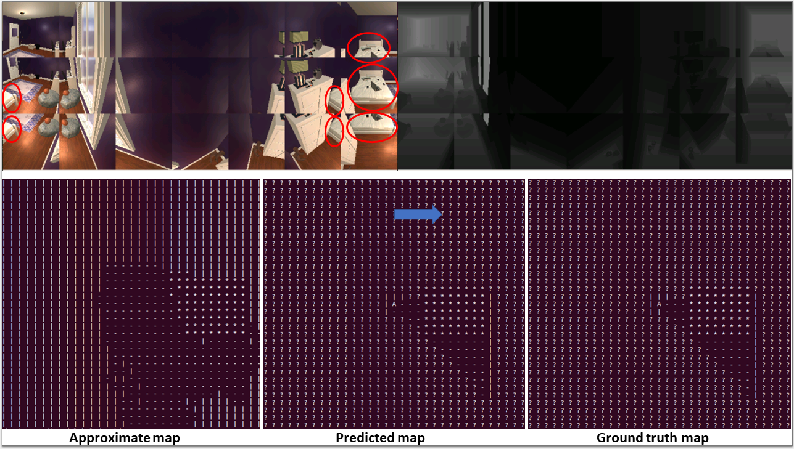
Example Mapping technique (1/2)
Notes:
Finally, we show some results on unseen environments after training the graph convolution
Our algorithm uses instance segmentation to construct the projection map
But once the approximate projection map is constructed, it is class agnostic
It recognizes only 4 unique classes
Target object circled in red
Navigable space which is basically the observed flooring
Obstructions which can be walls or any other object other than the target object and floor
And finally unknown space which can be unobserved spaces beyond obstructions
Unknown grids can be integrated with time and explicitly assigned to objects later on
On the top left we have the RGB panorama, on the top right we have the corresponding depth map
On the bottom left we have the approximate projection map with bed as the target object
The target object is represented by star sign, definite obstacles are represented by the pip symbol and question mark represents unknown grids
In mid we have the filtered ego centric projection and on the bottom right for comparison
We have the ground truth which is not accessible to the agent
We can see that the filtered and the ground truth almost match.
This approach is scalable to almost any unseen object because the graph convolution is class agnostic
Here the agent always localizes itself at the center of its ego centric map, represented as A
And the solid blue line indicates the agent perceived egocentric North direction

Slide 21
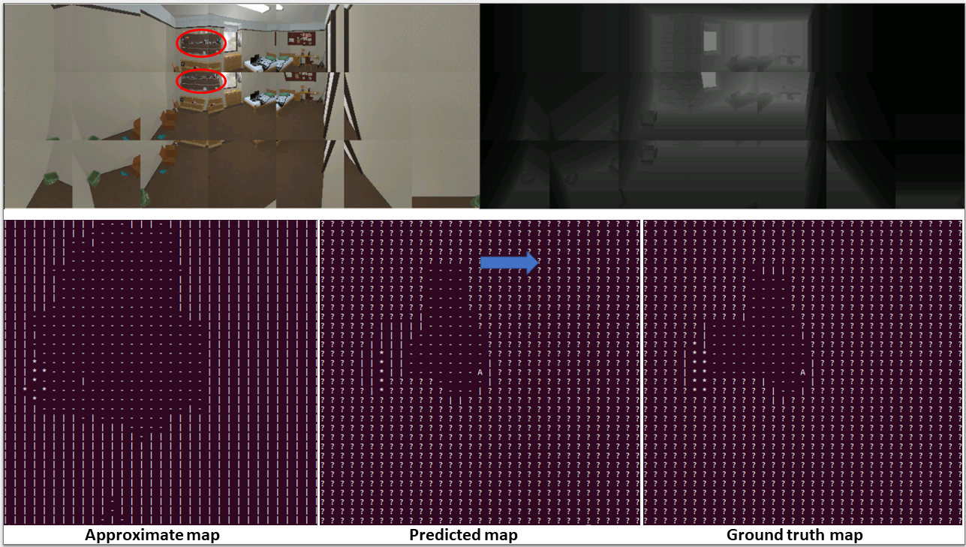
Example Mapping technique (2/2)
Notes:
As a second example here, the highlighted red object is a wall hanging drawer
And the graph convolution filtering is able to obtain an almost accurate projection

Slide 22
What grid wise filtering (GCN) does
After training on a set of rooms and different panorama images in different positions
The agent learns the general shape of any household object in BEV projection
Another vital transformation learned is the “Bounding box approximation”
The bounding box of the filtered projection can enhance trajectory planning
Provides alternate trajectories to navigate to every object for example a bed can be reached from 4 sides
Notes:
What does our graph convolution approach really do?
(read)
Finally I am grateful to my colleague Qisai Liu who helped me run some experiments with this module

Slide 23
Language Understanding
We utilize a technique called semantic slot filling and use a pretrained model of BERT- (Bidirectional Encoder Representations from Transformers)
Semantic slot filing
Assigns a label to each word of a sentence according to its role towards describing task fulfillment
Popularly used in conversational AI assistants, e.g. Alexa
Intent Classification
Assigns a label to the entire sentence depending on the user task
Notes:
Now we will talk about the language understanding module
I am grateful to my colleague Fateme Fotouhi for helping me with running experiments with this module
(click)
We utilize a technique called semantic slot filling and use a pretrained model of Bert- Bidirectional Encoder Representations from Transformers
The technique used here is called joint intent classification and semantic slot filing
(click) (click)
Semantic slot filing (read)
(click)
Intent classification (read)

Slide 24
Example NLU
Sentence
Carry the watch to the left side of the dresser facing the lamp
Intent
Manipulate and then navigate
Slot
(manipulate)
(target object)
(directions)
(relative object)
Utterance
Carry
Watch, lamp
left
Dresser
Slot
(O)
(O)
(O)
(target relative)
Utterance
the
to
of
facing
BERT can be trained using transfer learning on only a few thousand examples to adapt to this kind of task
Notes:
An example of the technique in action is shown here
Consider the example sentence carry the watch to the left side of the dresser facing the lamp
Here Intent is first manipulating an object and then navigate
By slots we assign a specific label to each word as shown here
Carry is assigned the label manipulate, watch and lamp are target objects, left is a direction
The,to and of are assigned null labels and so on

Slide 25
Labels
Slot Labels:
action_navi : navigation action words like → go, walk
action_n_navi : navigation action words like → open, heat
action_desc : description of the action → walk forward or turn right
action_intensity : The intensity of the action → a few steps
target_obj: The target object → go to the bed
target_rel : Something related to the object → top of the cabinet
refinement_obj : An object which helps us to find target object → go to bed next to the dresser
refinement_rel : Something related to the refinement object → go to bed next to the dresser
refinement_attri : Attribute of the refinement object → Red dresser
target_attri : Attribute of the target object → Blue bed
O : Rest of the words
Intent Labels:
1. navigation
2. n_navigation
Notes:
For this work we proposed 11 different kinds of slot labels which can be easily increased depending on changing problem types
And 2 different kind of intent labels – an instruction is either classified as a navigation instruction
or a manipulation or not_navigation instruction
If you are interested we can come back later to this slide and
I can explain the individual meaning of each semantic slot label

Slide 26
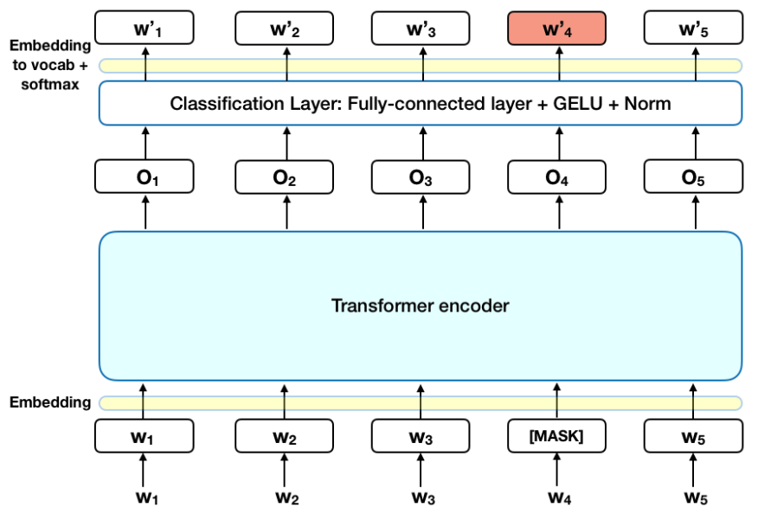
BERT training
Notes:
https://towardsdatascience.com/bert-explained-state-of-the-art-language-model-for-nlp-f8b21a9b6270
BERT makes use of Transformer, an attention mechanism that learns contextual relations between words (or sub-words) in a text. In its vanilla form, Transformer includes two separate mechanisms — an encoder that reads the text input and a decoder that produces a prediction for the task.
As shown in the figure here, we take a pretrained transformer encoder that has learned its weights over various other sentence classification datasets
The encoder takes in for example each input words w1 to w5 and converts it to hidden encodings O1 to O5
After that, the hidden embedding is passed through a classification layer that outputs w1 dash to w5 dash These are supposed to be the semantic slot labels for each word in our case
In our work, we finetune the final classification layer over a small labeled dataset for vision language navigation prepared by us
To achieve considerable accuracies, we only need around a 1000 supervised labels for the vision language scenario with our proposed labels

Slide 27
Cross Modal Grounding
Segmenting regions in an image based on descriptions in natural language
Forms the core of several visual question answering frameworks
Utilize a multimodal U-net architecture
Our multimodal segmentation combines
Prior described natural language understanding technique
Pretrained ResNet features from ImageNet image classification
Self supervised training data generation
Notes:
Another important module in our framework that understands the relationship between the observed images and
described languages is the cross-modal grounding. It is responsible for
(read)

Slide 28
Semantic knowledge graphs
Dresser
What is the relationship of the objects to each other ?
How do the objects influence the task that needs to be performed ?
Drawer
Watch
Inside
next to
contains
beside
Drawer
open first
Put stuff
Table
also called
under
contains
Chest
Desk
Pencil
Notes:
In order to generate training data in a self supervised fashion, we have to extract semantic knowledge graphs from the environment
The semantic knowledge graph can be extracted by mining relationships from provided natural language instructions
As we have shown earlier, our finetuned BERT model can predict semantic labels for each word in the sentence
When two objects are mentioned in the language instruction, they can be connected to each other in form of a graph based
upon a relationship described between them, which is also derived from our language understanding model.
Connecting all described object pair relationships gives us a knowledge graph which serves to answer 2 main questions
What is the relationship of the objects to each other?
How do the objects influence the task that needs to be performed?

Slide 29
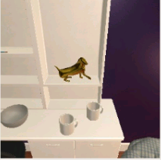
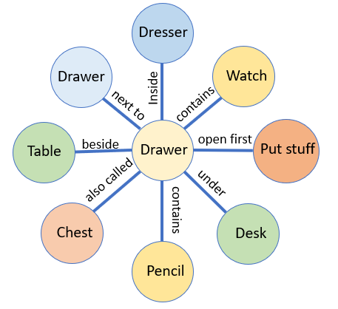
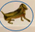
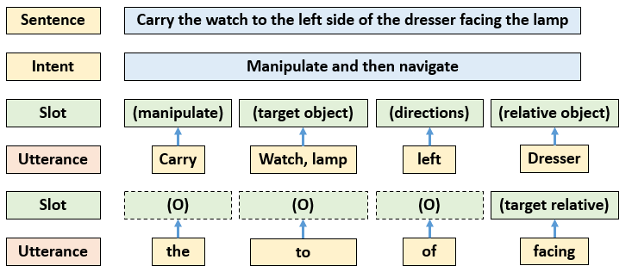


Self supervised data generation
1. Using standard object detection randomly chose candidate objects
2. Utilize bounding box positions and depth normal data to assign prepositions
3. Augment prepositions by choosing edge relationship from the mined knowledge graph
4. Utilize slot labels to produce ordered language description
Notes:
Now we will describe the steps involved in generating the self supervised training data
In step 1 we use standard object detection on the RGB image to randomly chose candidate objects
Here in the example we have chosen Bowl, 2 mugs and a dog statue
In step 2, we analyze the pixel positions of the bounding box centers of these objects and assign basic prepositions
Such as the Bowl is below the dog statue and there are 2 mugs and so on
In step 3 we can assign additional attributes by extracting relationships from the knowledge graph
For example we see that the bowl is on the table and can be beside a drawer.
Once we confirm this visually
We can add this to the description
Finally in step 4 based on the semantic labels of each word that we talked about earlier,
We can order the objects along with their prepositions
For example we can set a target object to be Bowl and a target refinement object to be the dog statue
Now we can produce a language description automatically like … the Bowl on the table below the dog statue
and for the segmentation target we simply select the bounding box area around the bowl

Slide 30
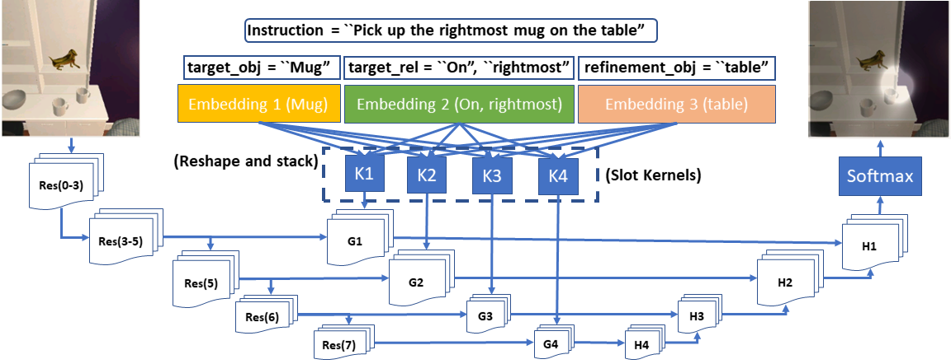
Training Framework
Notes:
Now we will describe the model architecture
It is similar to the U-net autoencoder architecture where you supply input image
and output the segmentation image
We also use pretrained Resnet layers trained on ImageNet. The input RGB image first passes through this pretrained layers
but additionally here remember the self supervised language instructions we generated earlier?
We put that in the input along with the image
The words in the language description go through an embedding and are converted into
A group of continuous vectors with the size of the embedding dimension
These embedding vectors are now resized into convolutional filters
Which are convolved over the output features of the pretrained Resnet filter layers
The decoder architecture is the same as Unet and finally we predict the segmentation mask on top of the RGB image

Slide 31
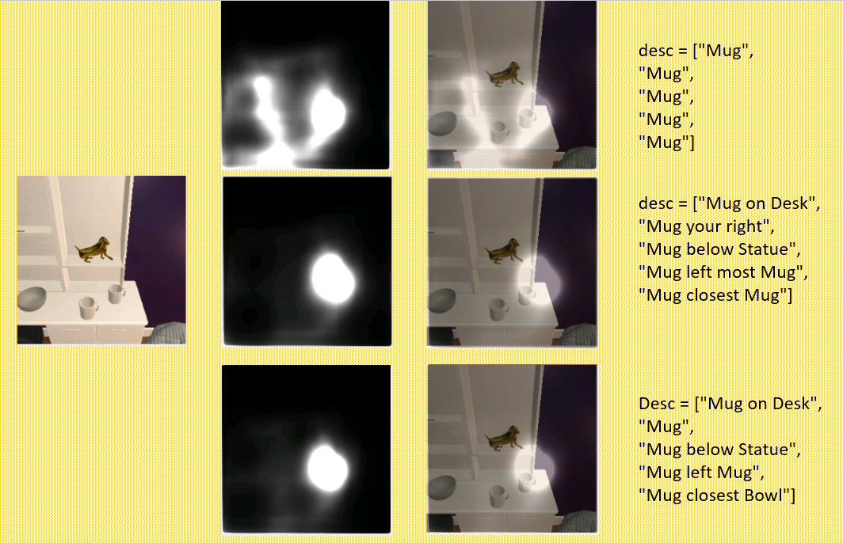
Cross Modal Grounding Example (1/2)
Notes:
Here we can see some examples of input and output of our trained framework
For the given input RGB image first we set the description to all Mugs on the top right
And correspondingly we get a mask that overlaps both the mugs in the picture
But if we modify a part of the description as the mug closer to bowl or the mug below statue,
one of the mugs get strongly segmented

Slide 32
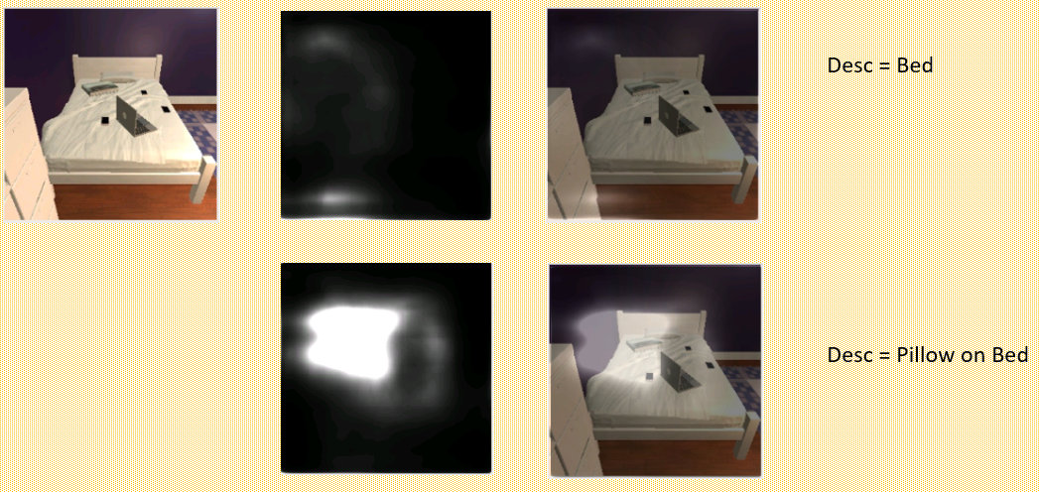
Cross Modal Grounding Example (2/2)
Notes:
We can do the similar thing with another picture over here
When the description is supplied as bed a faint mask is predicted all over the image
But if we change the description to pillow on bed
The region close to the pillow gets strongly segmented

Slide 33
Disambiguation
Ambiguity can occur very easily when object recognized by the vision system is called by a different name in the language
Say that segmentation classifier detects object class as a dog-bed but user calls it bean-bag. Another example would be Cup and Mug
We propose a 2-way disambiguation strategy that can leverage online knowledge base
1 step grounding
2 step grounding
Notes:
Now we will talk about disambiguation
(read)

Slide 34
1 step grounding
Disambiguate Cup and Mug/ Pick up the Mug but segmentation class is Cup
Download N images for segmentation class “Cup”
Pass each of the N images through pretrained resnet to generate feature embeddings
4. Compare embeddings obtained in step 2 and 3 and pick the closest match
3. Pass each bounding box region into pretrained resnet classifier to get embeddings
Notes:
(read)

Slide 35
2 step grounding
Disambiguate Cup and Mug/ Pick up the Mug but segmentation class is Cup
Download N images for segmentation class “Cup”
Pass each of the N images through pretrained resnet to generate feature embeddings
“Bowl”/ “Cup”/”Cup”/”Statue”
4. Download 1 google image for each of these object names and pass those images through rennet to get feature embedding
3. Get the class names of these objects from the segmentation framework
5. Compare embeddings in step 2 and 4
Notes:
(read)

Slide 36
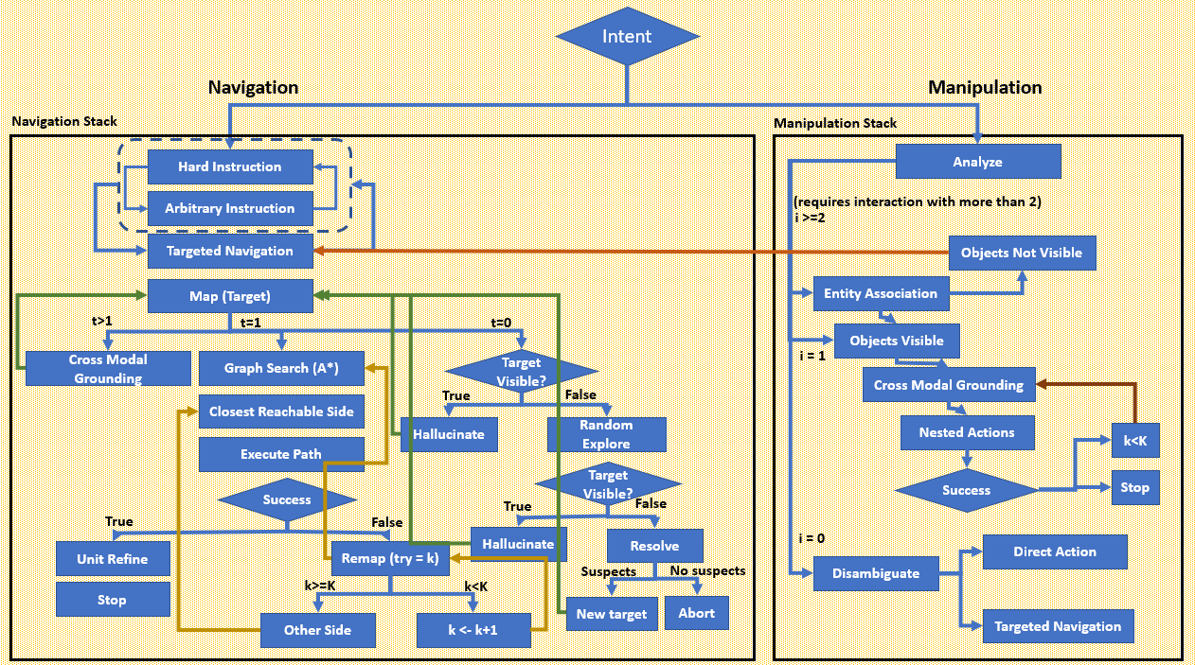
Planning
Notes:
Finally we come to the planning module
We propose a rule tree based planning that integrates information from all the modules together
The figure here summarizes the rule tree
First based on the language instruction we predict whether a navigation task or a manipulation task is expected.
For compositional tasks like carrying objects from one place to another the task is broken down
into sequence of simpler manipulation and navigation tasks
For pure navigation tasks, the semantic labels predicted for each word is analyzed to find out the type of navigation expected
We found out three general type of navigation commands
First type is hard instruction for example, walk forward 2 steps or turn left
Then there are visually grounded navigation which we call arbitrary navigation because it can cover a wide range of compositional instructions
like walk until you reach the end of the room, or walk in between the bed and chair to your left
In these cases the cross modal grounding module analyses the joint information
Finally there are targeted navigations like walk to the dresser or go to the left side of the desk
Arbitrary instructions can also be split into sequence of hard and targeted instructions
Once a navigation target is decided the graph convolution filtering is used to create an egocentric projection map
Of the bounding box of the target and the navigable space around an agent
Targets can remain unresolved when there are multiple occurrences like when the user says move to a chair
but multiple chairs are present. Again the cross modal grounding and disambiguation modules are used
There are also several checks to make sure the target is not blocked out and random exploration is also introduced
When there are too many obstructions. If target is visible but too far away to accurately create a map, a hallucination step
Progressively takes the agent closer towards the target. In such cases an area maximization heuristic has been used which takes the action
Which maximizes the area of the instance segmentation of the visible object.
A* search can be directly used to plan paths on agent egocentric map
Several similar techniques also have been used for object manipulation which I can discuss if you have
Further interest

Slide 37
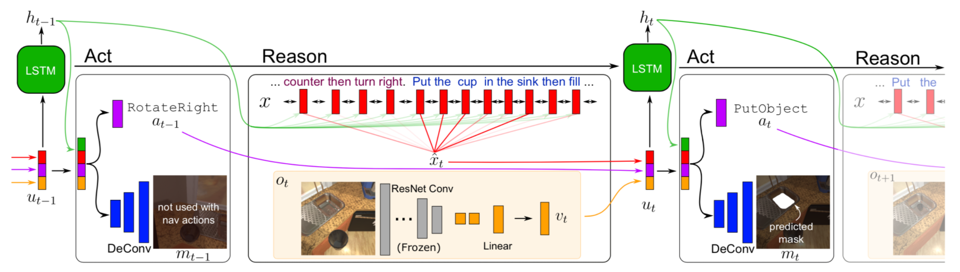
Baseline sequence to sequence model
6. Shridhar, Mohit, et al. "Alfred: A benchmark for interpreting grounded instructions for everyday tasks." Proceedings of the IEEE/CVF conference on computer vision and pattern recognition. 2020.
Notes:
We now explain the baseline model proposed by the authors of the data set.
This baseline model like most existing frameworks does an upfront feature level fusion and then predicts sequence of actions using LSTM.
As you can see the input image is first passed though pretrained resnet layers to get vt , for the instruction an embedding xt is obtained
Vt and xt is combined with previous action taken by the agent to form the input vector to the LSTM called ut
It is trained by using expert demonstrated actions
The authors also introduce another variant called sequence to sequence + PM or performance monitoring
Here an additional loss is calculated by trying to predict the progress of the agent in performing tasks towards the final goal
This is similar to learning a value function in reinforcement learning and was implemented by adding an additional module to the LSTM

Slide 38
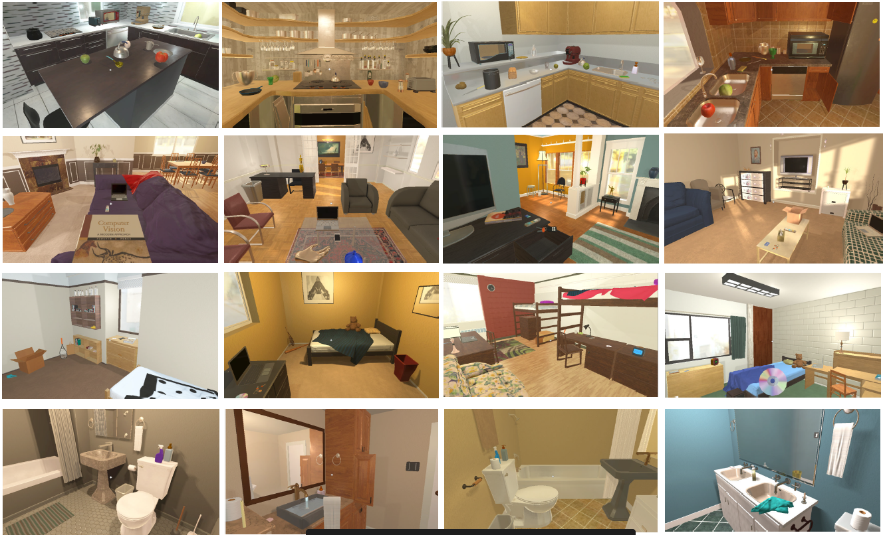
Training and testing
36,000 training trajectories
6,000 test trajectories
120 unique rooms built in unity environment - 90 training + 30 test
Notes:
For training the authors baseline a total of 36,000 demonstration trajectories were used
Trajectories were demonstrated in different settings such as in bedrooms, kitchens and bathrooms
Comprising a total of 120 different rooms
For testing a total of 6,000 different trajectories corresponding to 6000 independent tasks were picked up
We made sure that the rooms used for testing were never seen by the agent in the training
For training our algorithm as we have mentioned earlier no trajectory data is required
So we used 1000 different natural language instructions representing roughly 1000 different tasks provided to the agent
The training tasks were a subset of the training tasks used for training the author baseline
For training our cross modal grounding module again we used the same training room but the labels were generated using self supervised strategy
For training our graph convolution filtering we used 30 rooms from the 120 different training rooms
And placed the agent at each position in the room to obtain panorama data

Slide 39
Performance metrics
Task success rate
Measure of overall success for the entire 4-5 lines of textual instruction
Goal condition success rate
Measure of number of “sub-goals” achieved/ slightly lenient metric
Path weighted metrics
All metrics can be reweighted based on number of steps taken compared to a demonstrator for the same task
Notes:
Now we talk about the performance metrics used to evaluate our algorithm
We bring back the example we had used earlier
The first metric is task success rate
Is it basically the average percentage of tasks succeeded out of all provided tasks to the agent
In this example if we look at the goal- pick up the box, put it in a chair, put a credit card
Inside and close it. If the agent is able to satisfy all the conditions in this goal then the task is
Regarded as a success
However, say the agent fails at the very last action and does not close the box, then the whole
Task is a failure. So we have a more lenient metric called goal condition success rate
According to that the agent can check out each of the instructions comprising the goal
If the agent is able to execute instructions 1 though 7, but not the last 8th instruction,
Then the goal condition success rate will be 7/8
Finally we have path weighted metrics for the above two metric which is basically obtained
By multiplying the task success rate and goal condition success rate by a ratio r
The ratio r is the fraction obtained by the number of actions taken by the expert demonstrator
Divided by the number of actions taken by the AI algorithm

Slide 40
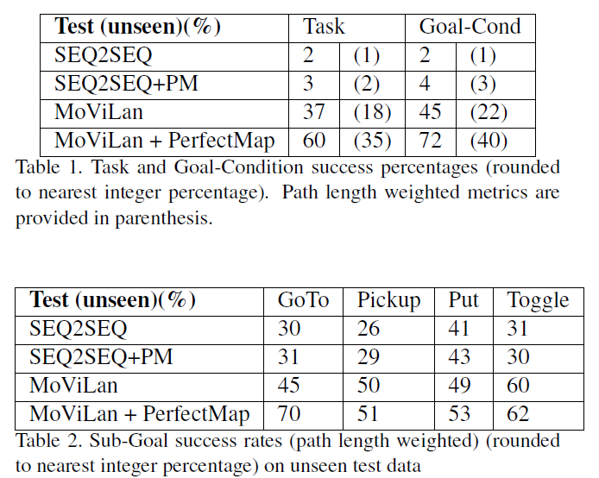
Benchmark Comparison
Notes:
Here are the results for the comparison of our method with the authors
For the top table we report the metrics we just explained earlier
The authors technique at best achieves 3% task success rate on unseen rooms whereas ours can achieve 37%
If additionally ground truth map of the room is provided to the agent, our method can obtain up to 60% success rates
In the bottom table we present path weighted success rates for 4 individual subgoal types
GoTo means the agent was instructed to purely navigate somewhere
Pickup means instructed to pick up an object
Put means instructed to place an object somewhere
And toggle means instructed to turn an appliance on or off
Excepting the Put subgoal, our method is almost twice better in terms of subgoal success
For Goto, Pickup, and Toggle

Slide 41
Future Work
Deep Learning + Rule based composite planner
Deep learning decides which rule to apply when
Rule based tree but execution (how much to turn how much to move) executed by deep RL algorithms such as policy gradient
Entirely deep learning-based policy, but trained partially using trajectories generated by rule-based technique
Multi agent deep reinforcement learning
Currently the information sharing between language and vision module coordinated by a rule-based planner. Can use MARL instead with number of communication bits as a parameter
Notes:
For future work we are expecting to explore in 2 different directions
First is trying to create a deep learning + rule based composite planner
It can be done in 3 ways
(read)
Another direction is the use of multi agent reinforcement learning
(read)

Slide 42
Conclusion (1/2)
We proposed various techniques in multimodal machine learning for decision making under uncertainty
Granger causality-based clustering proposed to fuse different time series which could originate from independent modalities (Representation based decision level fusion)
State switching DQN achieve multi-modal fusion, but modalities differ based on event type, not sensor type (multi camera) (Event based decision level fusion)
MARL learns communication strategies across a team of RL agents (Goal based decision level fusion)

Slide 43
Conclusion (2/2)
MOVILAN is a combination of all above types-
Representation based (Language understanding and cross modal grounding)
Event based (user creates the event by typing natural language instruction)
Goal based (Natural language instructions create a goal for the rule-based planner)

Slide 44
Publication list (1/2)
Journals
H. Saha, A.R. Florita, G.P. Henze, & S. Sarkar. (2019). Occupancy sensing in buildings: A review of data analytics approaches. Energy and Buildings.
H. Saha, C. Liu, Z. Jiang, & S. Sarkar. (2019). Data driven performance monitoring of dynamical systems using Granger causal graphical models. ASME journal of Dynamics Measurement and Control.
T. Gao, H. Saha,H. Emadi, J. Zhang, A. Lofquist, A. Singh, B. Ganapathysubramanian, S. Sarkar, A. Singh, S. Bhattacharya. "A Novel Multirobot System for Plant Phenotyping." Robotics 7, no. 4 (2018): 61.
Submitted first draft of this work to Nature Machine Intelligence
Notes:
List of courses needed

Slide 45
Publication list (2/2)
Conferences
H. Saha, V. Venkataraman, A. Speranzon, & S. Sarkar (2019). A perspective on multi-agent communication for information fusion. In 2019 VIGIL workshop NeurIPS.
H. Saha, S.Y. Tan, Z. Jiang, and S. Sarkar, 2019. “Learning state switching for multi sensor integration”. In 2019 Indian Control Conference (ICC), IEEE.
H. Saha, C. Liu, Z. Jiang, and S. Sarkar, Exploring granger causality in dynamical systems modeling and performance monitoring, Conference on Decision and Control, 2018.
H. Saha, T. Gao, H. Emadi, Z. Jiang, A. Singh, B. Ganapathysubramanian, S. Sarkar, A. Singh, S. Bhattacharya, "Autonomous Mobile Sensing Platform for Spatio-Temporal Plant Phenotyping." ASME 2017 Dynamic Systems and Control Conference. American Society of Mechanical Engineers, 2017.
S.Y. Tan, H. Saha, A.R. Florita, G.P. Henze, & S. Sarkar (2019, July). “A flexible framework for building occupancy detection using spatiotemporal pattern networks.” In 2019 American Control Conference (ACC) (pp. 5884-5889). IEEE.
S.Y. Tan, H. Saha, M. Jacoby, A.R. Florita, G.P. Henze, S. Sarkar (2020 February). “Granger causality based hierarchical time series clustering for state estimation”. Accepted for publication in International Federation for Automatic Control (IFAC) proceedings.
T. Gao, H. Emadi, H. Saha, J. Zhang, A. Lofquist, A. Singh, B. Ganapathysubramanian, S. Sarkar, A. Singh, and S. Bhattacharya. "Navigation Strategies for a Multi-Robot Ground-Based Row Crop Phenotyping Platform." In ASME 2018 Dynamic Systems and Control Conference. American Society of Mechanical Engineers Digital Collection, 2018.
Notes:
List of courses needed

Slide 46
List of courses
ME 557 - Computer graphics and geometric modelling
ME 585X- Fundamentals of predictive plant phenomics
ME 511- Advanced control design
ME 592X- Machine learning Cyber physical system
ME 573- Random signals and Kalman filtering
COMS 531- Theory of computation
COMS 573- Machine learning
MATH 565- Continuous optimization

Slide 47
List of courses
COMS 511- Advanced design and analysis of algorithms
COMS 572- Principles of artificial intelligence
ME 577- Linear systems
COMS 576X- Motion strategy algorithms
COMS 634- Theory of games and uncertainty
ME 578- Nonlinear systems
COMS 527X- Concurrent systems

Slide 48


Slide 49
Slide improvement
Add more discussion/formulation of the actual optimization framework? Loss functions, updates and such?
Provide more lit review on why multi agent actor critic approach?
Provide any new results?/tables?
Read in detail about the entire theory behind actor-critic/MADDPG technique
Overall intuition why this technique works + entire algorithm
Gumbel softmax technique

Slide 50
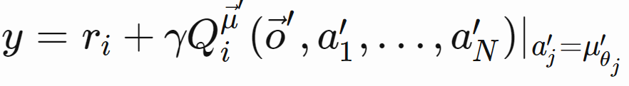
Update equations
Actor updated its weights according to the gradients
Critic updates its weights according to the loss function
Bootstrapping
More Explanation:
Meet me offline

Slide 51
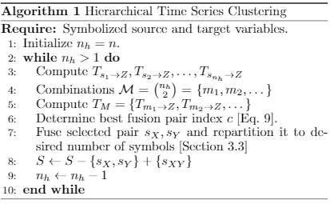
Time series clustering algorithm

